Slide 1

Summer Internship at PDPM IIIT DM Jabalpur Biometric Template Protection using Cancelable Biometrics This work is supported by BRNS, Dept. of Atomic Energy, Government of India.
Presented By:
Arpita Nema
(0201CS151016)

Slide 2
Contents
Introduction
Research Gap and Contributions
Proposed Template Transformation Schemes
XOR based template transformation.
Random Distances based template transformation.
Random Slope based template transformation.
Polynomial based template transformation.
Conclusions
References

Slide 3
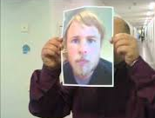
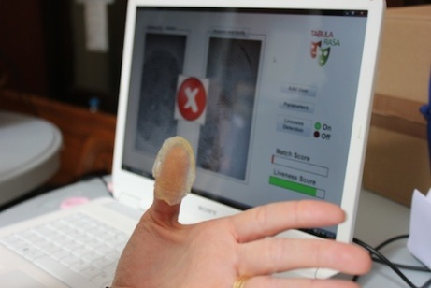
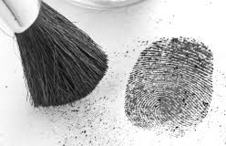
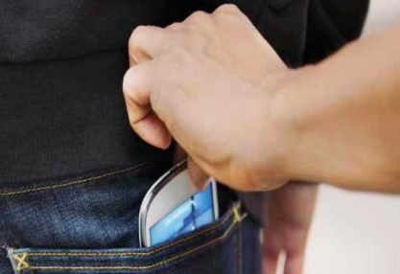
Biometrics - A Double Edged Sword
Biometrics - the most advanced security solutions in the market.
Biometrics offers greater security and convenience than traditional methods of personal recognition.
Biometrics for security and security for biometrics
Risks - Leaking a Biometric is a Disaster
Password leaked? Fine, you can easily replace with a new one.
Fingerprint leaked? Leaked for the rest of your life.
Lack of general solutions leaves this as a challenging issue.
Notes:
cannot be forgotten, difficult to forge, and provides a very strong access control security solution satisfying authentication, confidentiality, integrity, and non-repudiation.
Due to the rapid growth in sensing and computing technologies, biometric systems have become affordable and are easily embedded in a variety of consumer devices (e.g., mobile phones, key fobs, etc.), making this technology vulnerable to the malicious designs of terrorists and criminals.
A framework is proposed to solve this problem

Slide 4
Biometric Template Protection
Template Protection
Hardware level
Software level
Protocol level
Multi-party communication
Hommomorphic communication
Private information retrieval
Tamperproof h/w
Smartcard assisted h/w
Trusted platform
Cryptosystems
Feature Transformation
Template Image Transformation
Cancelable Biometrics
Key-binding
Key-generation
Biometric Salting
Non-invertible transforms
Steganography
Watermarking
Visual crypto-graphy
Biometric Encryption
Fuzzy vault
Fuzzy commitment
Quantization
Fuzzy extractor
Secure sketches
Random projection
Random con-volution
Random noise
Surface folding
Biotokens
Block permutations

Slide 5
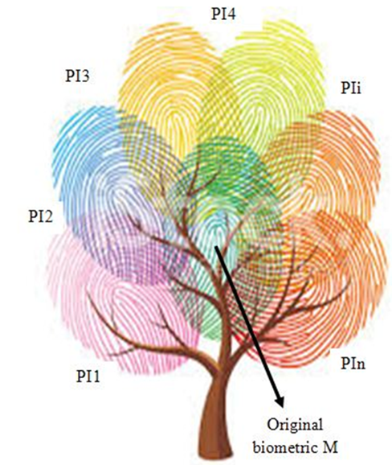
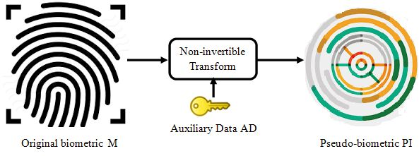
Cancelable Biometrics
Regenerate biometrics like passwords.
Use ‘pseudo-identity’ PI instead of original biometric for storing, matching and other authentication tasks.
Assign a token to every enrollee which generates/lead to generate this user-specific secret information, AD.
In case of a compromise only pseudo-identity PI is lost, which cannot be inverted to learn original biometric.
Notes:
Transform biometric M, in a non-invertible manner, to generate ‘pseudo-identity (PI)’ using user-specific secret information /auxiliary data, AD.
A new pseudo-identity can be regenerated by changing transformation function/parameters.
Same biometric maps to different pseudo-identities for secure usage over multiple applications.
This way user is free from intrusions, remains autonomous and retains control over the use of its biometric information.

Slide 6
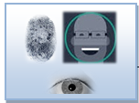





Basic Cancelable Authentication System
ENROLLMENT
Process biometrics
Original biometric is discarded after generating pseudo-biometric
$$B$$
Cancelable transformation
Input biometric
Pseudo-biometric identity (PI)
Random Data Generation
token
Database Server
AUTHENTICATION
Process biometrics
$$PI$$
Matching without decryption
$B$’
Cancelable transformation
$PI$’
Matcher
Input biometric and user specific token
token
Accept/ Reject

Slide 7
Properties of Cancelable Transform
Four important requirements [8]
Revocability : Straight forward revocation of a compromised template.
Diversity: No correlation/cross-matching of pseudo-identities.
Non-invertibility: No possibility to recover original identity by inverting pseudo-identity.
Performance: Discriminative content of biometric template must be preserved. FAR/FRR must be low.
Transforming a biometric template in a revocable manner such that it fulfills all the four criteria of revocability, diversity, non-invertibility and performance is a challenging task!

Slide 8
Major Transformation Schemes
Biometric salting
Random Projection: BioHashing , Multiple Random Projections
Random Convolution: BioConvolving, Random kernels, curtailed circular convolution
Random Permutations: Block permutation, GRAY/BIN-COMBO
Random Addition: BioPhasoring, GRAY/BIN-SALTING
Non-invertible transforms
Geometric transforms- Cartesian, Surface and Polar transforms [9]
Hash functions etc.
There exists many drawbacks for the schemes as analyzed during literature survey.
Notes:
GRAY-COMBO, transforms the Gabor features by circularly
shifting and adding rows at random. BIN-COMBO, the second
method, applies similar transformations on the iris codes by random
shifting and XOR-ing.
GRAY-SALTING, BIN-SALTING
These methods add random
patterns or synthetic iris patterns to the Gabor features

Slide 9
Research Gap
Limited number of biometric salting techniques, many of which are susceptible to inverse.
Non-invertible transforms tend to trade-off discriminability.
Performance for most approaches are evaluated only for best-case scenario.
Best-case: different tokenized data to each user
Worst-case: same tokenized data to each user
Applicability of most transforms is restricted only to particular modalities.
In general, biometric recognition techniques have to deal with the problem of high storage requirements due to large template sizes.

Slide 10
Objectives & Contributions
To improve existing techniques and to discover new transformation techniques for generating secure, privacy preserving, and revocable biometric templates with reduced dimensionality.
Signal level transformations:
Random Project based template transformation
Feature level transformations:
XOR based template transformation
Random distance based template transformation
Random slope based template transformation
Polynomial based template transformation

Slide 11
Performance Metrics
Matching Performance:
Verification (1:1): Equal Error Rate (EER) and Decidability Index (DI)
Identification (1:N): Correct Recognition Rate (RI).
Desirable: (1) low EER, high DI, high RI; (2) worst-case performance must be comparable to original; (3) Best-case better.
Changeability Performance:
Correlation Index (CI), Cross-matching EER, and genuine, impostor and pseudo-impostor population distribution statistics.
Desirable: (1) low CI, high EER; (2) Genuine different from impostor and pseudo-impostor resembles impostor.
Non-invertibility:
Separately analyzed for each approach.

Slide 12
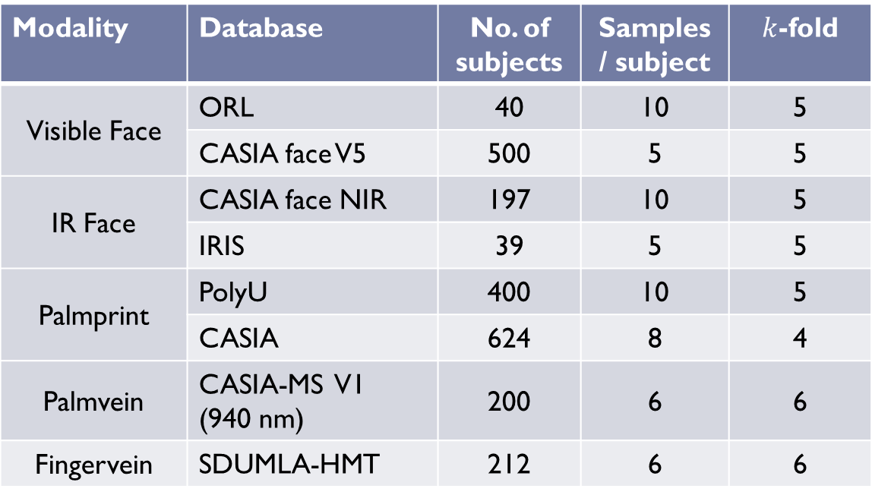
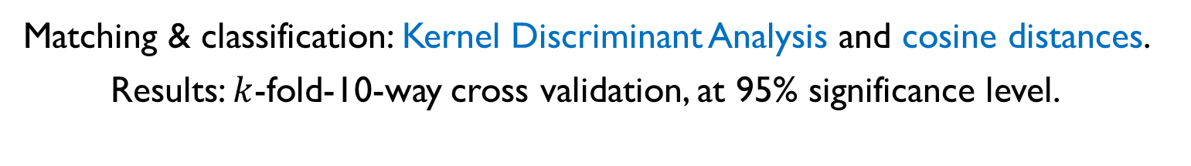
Databases used for Experimentation
Modality | Database | No. of subjects | Samples / subject | $k$-fold
Visible Face | ORL | 40 | 10 | 5
 | CASIA face V5 | 500 | 5 | 5
IR Face | CASIA face NIR | 197 | 10 | 5
 | IRIS | 39 | 5 | 5
Palmprint | PolyU | 400 | 10 | 5
 | CASIA | 624 | 8 | 4
Palmvein | CASIA-MS V1 (940 nm) | 200 | 6 | 6
Fingervein | SDUMLA-HMT | 212 | 6 | 6
Matching & classification: Kernel Discriminant Analysis and cosine distances.
Results: $k$-fold-10-way cross validation, at 95% significance level.

Slide 13
1. XOR based Template Transformation
Motivation: A new salting approach competitive to RP with less complexity

Slide 14
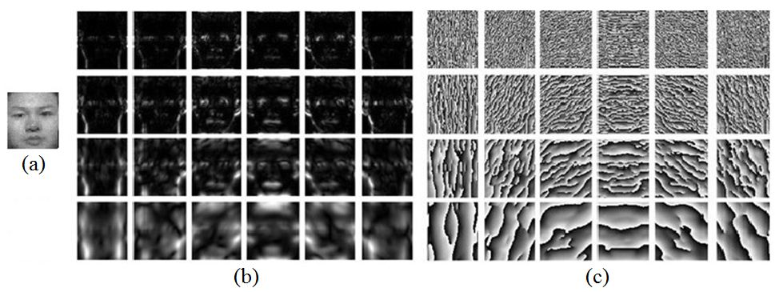
Log-Gabor Filters
Input image Feature extraction Feature transformation.
Feature extraction
Log-Gabor filters at multiple scales (4) and orientations(6).
Significant increase in dimensionality of feature (24 times).
Fig. Sample images for log-Gabor filtering (a) Original image, (b)-(c) Log-Gabor magnitude and phase patterns at n=4 scales and m=6 orientations.

Slide 15



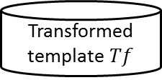

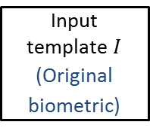




Proposed Approach
Multi-level Distortions using Random Projections and XOR based Salting
Random Projection is used to reduce dimensionality by 50% at signal level
De-sampling reduces dimensionality by 50% at feature level
Input template $I$
(Original biometric)
Random
Projection
$$I^{RP}=RI$$
log-Gabor
filtering
$$Xmag$$
$$Xph$$
$${fm}_{m,n}^{}$$
De-sampling
$${Tf}_{m,n}^{}$$
Median filtering
user- specific token
Key matrix $R$
Random Grid $RG$
XOR
$${fs}_{m,n}^{}$$
Transformed template $Tf$
Input user-specific token $R \&$ $RG$
Signal level distortion
Feature level distortion
(Pseudo-biometric)
H. Kaur, P. Khanna, “Cancelable features using log-Gabor filters for biometric authentication,” Multimedia Tools and Applications, vol. 76, no. 4, pp. 4673--4694, 2017.

Slide 16
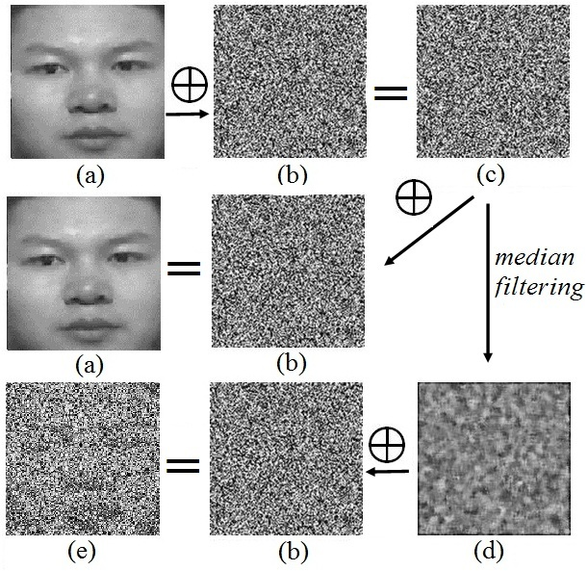
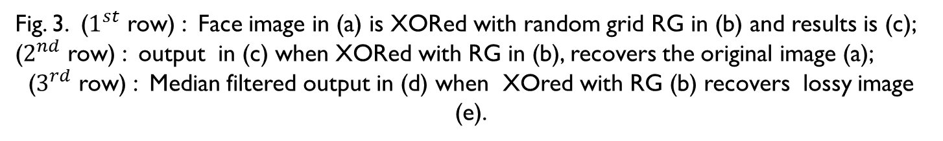
Non-invertibility using Median Filtering
Fig. 3. ($1^{st}$ row) : Face image in (a) is XORed with random grid RG in (b) and results is (c); ($2^{nd}$ row) : output in (c) when XORed with RG in (b), recovers the original image (a);
($3^{rd}$ row) : Median filtered output in (d) when XOred with RG (b) recovers lossy image (e).

Slide 17
Performance Notes:
Dimensionality Reduction
Single-level (XOR): 50%, Multi-level (RP-XOR): 75%
Matching Performance (worst-case):
XOR at 50% reduction - slightly less, comparable to original .
XOR - better than RP-XOR and BioPhasor.
XOR at 50% reduction - less than BH at no reduction.
XOR at 50% reduction - better than BH-50 at 50% reduction.
RP-XOR at 75% reduction - comparable to BH-50, BioPhasor, and better than BH-75.
Matching Performance (best-case):
Nearly 0% EER, high DI (>25) and, nearly 100% RI.
Changeability Performance:
CI – low, Cross-matching EER is high, nearly 50%, indicating no-match.

Slide 18
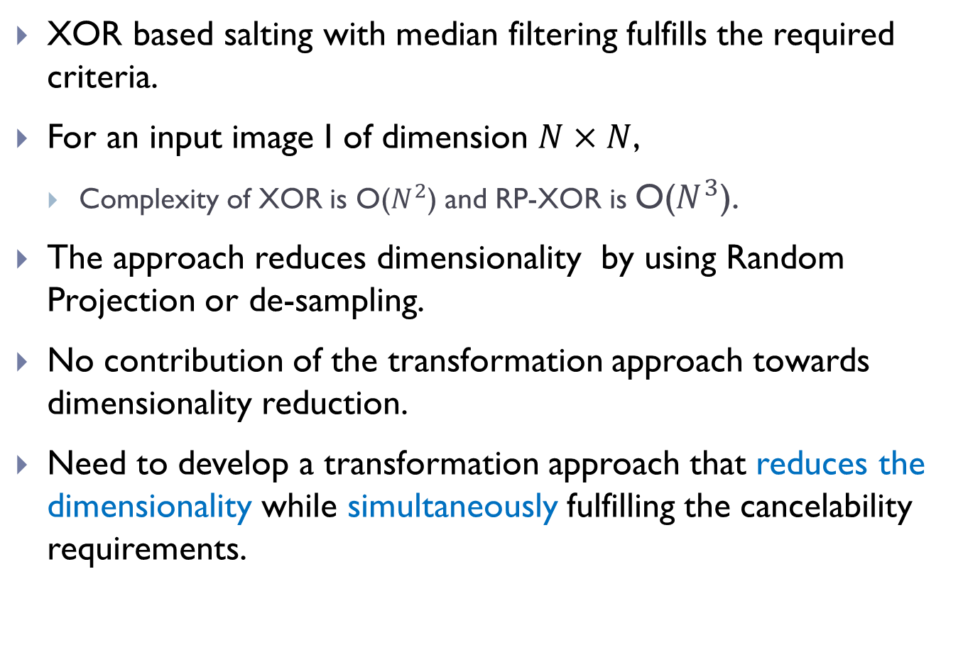
Observations
XOR based salting with median filtering fulfills the required criteria.
For an input image I of dimension $N×N$,
Complexity of XOR is O($N^{2}$) and RP-XOR is O($N^{3}$).
The approach reduces dimensionality by using Random Projection or de-sampling.
No contribution of the transformation approach towards dimensionality reduction.
Need to develop a transformation approach that reduces the dimensionality while simultaneously fulfilling the cancelability requirements.

Slide 19
2. Random Distance Method
Motivation- Reduce Dimensionality without RP

Slide 20









Proposed Concept
Random Distance Method: Let a feature vector $fv$be represented as a point ($x_{i},y_{i}$) in a Cartesian coordinate system. Then, instead of using original feature $fv,$its distance from some random point ($x_{0},y_{0}$) can be used for matching purposes.
Let $fv\text{ (}x_{1}\text{, }y_{1}\text{)}$, $fv$ ($x_{2}$, $y_{2}$) belong to same user and $fv$ ($x_{3}$, $y_{3}$) belong to different user.
Let random point be $rp$($x_{0}$, $y_{0}$).
Then it is proved that the distances $d_{1}$ , $d_{2}$ and $d_{3}$ are transformed features which carry the discriminative information of original features.
$fv$ ($x_{3}$, $y_{3}$)
$$d_{3}$$
$$d_{2}$$
$fv$ ($x_{2}$, $y_{2}$)
$rp$($x_{0}$, $y_{0}$)
$$d_{1}$$
$fv$ ($x_{1}$, $y_{1}$)

Slide 21











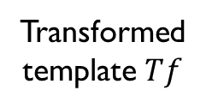



Proposed Approach
$$X_{1}$$
Dimensionality reduction by half= 50%
Image template
feature extraction
feature salting
Compute distance
Median filtering
$$Y_{1}$$
$$fv$$
$$fs$$
Transformed template $Tf$
$$(X_{0},Y_{0})$$
$$(X_{1},Y_{1})$$
$$D$$
$$X_{0}$$
Random key generation
$$d$$
$fs$ ($x_{1}$, $y_{1}$)
$$Y_{0}$$
$$K$$
$rp$($x_{0}$, $y_{0}$)

Slide 22
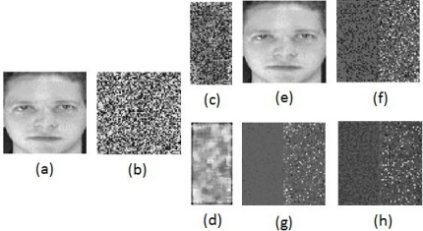
Non-invertibility using Median Filtering
Case(1)
Case(2)
Fig. 4 (a) Original feature, (b) Key $K$, (c) distance matrix $D$, (e) filtered distance matrix$Tf$, (e) and (f) recovered templates in case(1), and (g) and (h) recovered templates in case(2).

Slide 23
Performance Notes
Dimensionality Reduction
RDM reduces by 50%.
Matching Performance (worst-case):
RDM at 50% reduction - slightly less, comparable to original .
RDM at 50% reduction - better than XOR at 50% reduction and slightly less than BH at no reduction.
RDM at 50% reduction - better than BH-50 at 50% reduction.
RDM at 50% reduction - better than BioPhasor at no reduction.
Matching Performance (best-case):
Nearly 0% EER, high DI (>25) and, nearly 100% RI.
Changeability Performance:
CI is low for the approach.
Cross-matching EER is high, nearly 50%, indicating no-match.

Slide 24
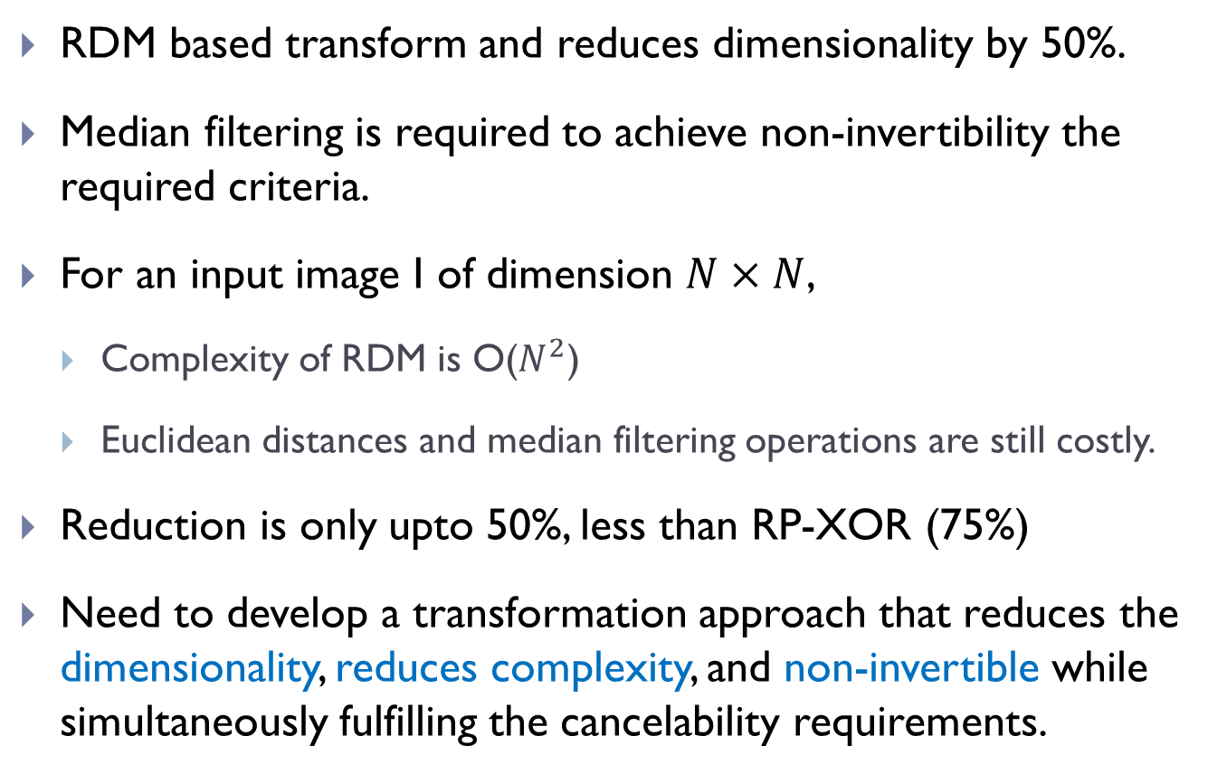
Observations
RDM based transform and reduces dimensionality by 50%.
Median filtering is required to achieve non-invertibility the required criteria.
For an input image I of dimension $N×N$,
Complexity of RDM is O($N^{2}$)
Euclidean distances and median filtering operations are still costly.
Reduction is only upto 50%, less than RP-XOR (75%)
Need to develop a transformation approach that reduces the dimensionality, reduces complexity, and non-invertible while simultaneously fulfilling the cancelability requirements.

Slide 25
3. Random Slope Method
Motivation- Further reduction in Dimensionality, non-invertible without median filtering

Slide 26



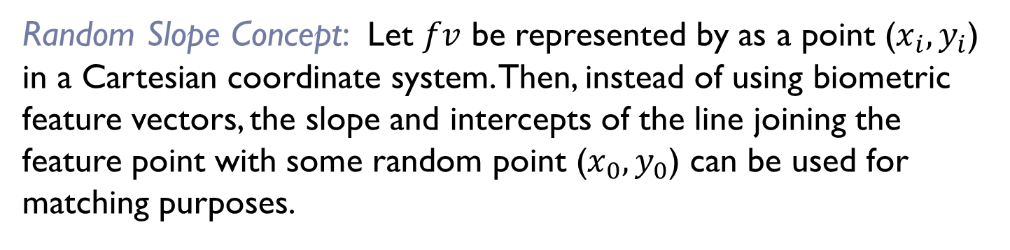


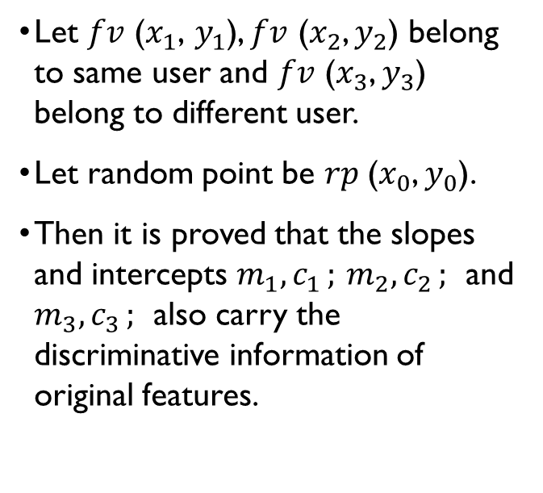



Proposed Concept
Random Slope Concept: Let $fv$ be represented by as a point ($x_{i},y_{i}$) in a Cartesian coordinate system. Then, instead of using biometric feature vectors, the slope and intercepts of the line joining the feature point with some random point ($x_{0},y_{0}$) can be used for matching purposes.
$fv$ ($x_{3}$, $y_{3}$)
Let $fv\text{ (}x_{1}\text{, }y_{1}\text{)}$, $fv$ ($x_{2}$, $y_{2}$) belong to same user and $fv$ ($x_{3}$, $y_{3}$) belong to different user.
Let random point be $rp$($x_{0}$, $y_{0}$).
Then it is proved that the slopes and intercepts $m_{1}{,c}_{1};$ $m_{2}{,c}_{2};$ and $m_{3}{,c}_{3};$ also carry the discriminative information of original features.
$rp$($x_{0}$, $y_{0}$)
$c_{1}$, $c_{2}$
$$m_{2}$$
$$m_{1}$$
$fv$ ($x_{2}$, $y_{2}$)
$m_{3}$, $c_{3}$
$fv$ ($x_{1}$, $y_{1}$)

Slide 27
















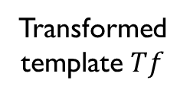
Proposed Approach-1/2 (RS-V1)
Dimensionality reduction by half= 50%
$$X_{1}$$
Image template
feature extraction
feature salting
Compute slope and intercept
Normalized and added
$$Y_{1}$$
$$fv$$
$$fs$$
$$(X_{0},Y_{0})$$
$$(X_{1},Y_{1})$$
$$M$$
Transformed template $Tf$
$$C$$
$$X_{0}$$
Random key generation
$fv$ ($x_{1}$, $y_{1}$)
$$R$$
$$intercept c$$
$$Y_{0}$$
($x_{0}$, $y_{0}$)
$$K$$
$$m=tan⁡(θ)$$

Slide 28







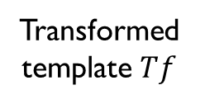








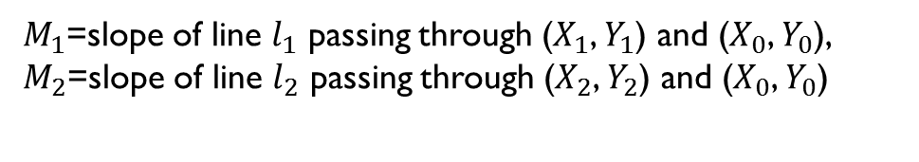

Proposed Approach- 2/2 (RS-V2)
Dimensionality reduction by ¼ = 75%
$$X_{1}$$
$$X_{2}$$
Sensor
feature extraction
feature salting
Calculate angle between two lines
$$Y_{1}$$
$$Y_{2}$$
$$M_{1}$$
$$M_{2}$$
Transformed template $Tf$
$$fv$$
$$fs$$
$$X_{0}$$
$tan⁡(θ)$=$\frac{m_{1}m_{2}}{1+m_{1}m_{2}}$
$$l_{2}$$
Random key generation
$fv$ ($x_{2}$, $y_{2}$)
$$K$$
$fv$ ($x_{1}$, $y_{1}$)
$$Y_{0}$$
$$l_{1}$$
$M_{1}$=slope of line $l_{1}$ passing through ($X_{1}$, $Y_{1}$) and ($X_{0}$, $Y_{0}$),
$M_{2}$=slope of line $l_{2}$ passing through ($X_{2}$, $Y_{2}$) and ($X_{0}$, $Y_{0}$)
($x_{0}$, $y_{0}$)

Slide 29
Performance Notes
Dimensionality Reduction
RS-V1 reduces by 50% and RS-V2 reduces by 75%.
Matching Performance (worst-case):
RS-V1 at 50% reduction - slightly less, comparable to original .
RS-V1 at 50% reduction - better than RDM and XOR at 50% and BH at no reduction.
RS-V2 at 75% reduction - comparable to XOR at 50% and better than BH-50 at 50% reduction.
RS-V1and RS-V2 - better than BioPhasor at no reduction.
Matching Performance (best-case):
Nearly 0% EER, high DI (>25) and, nearly 100% RI.
Changeability Performance:
CI – low, Cross-matching EER is high, nearly 50%, indicating no-match.

Slide 30
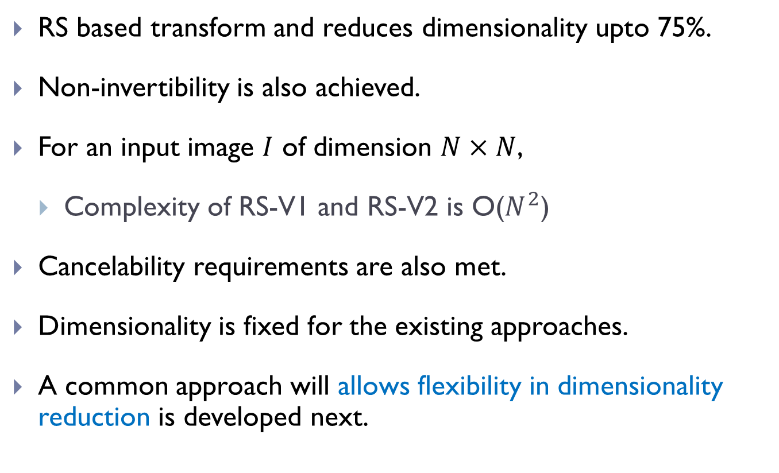
Observations
RS based transform and reduces dimensionality upto 75%.
Non-invertibility is also achieved.
For an input image $I$ of dimension $N×N$,
Complexity of RS-V1 and RS-V2 is O($N^{2}$)
Cancelability requirements are also met.
Dimensionality is fixed for the existing approaches.
A common approach will allows flexibility in dimensionality reduction is developed next.

Slide 31
4. Polynomial Transformation Method
Motivations- Flexible dimensionality reduction

Slide 32
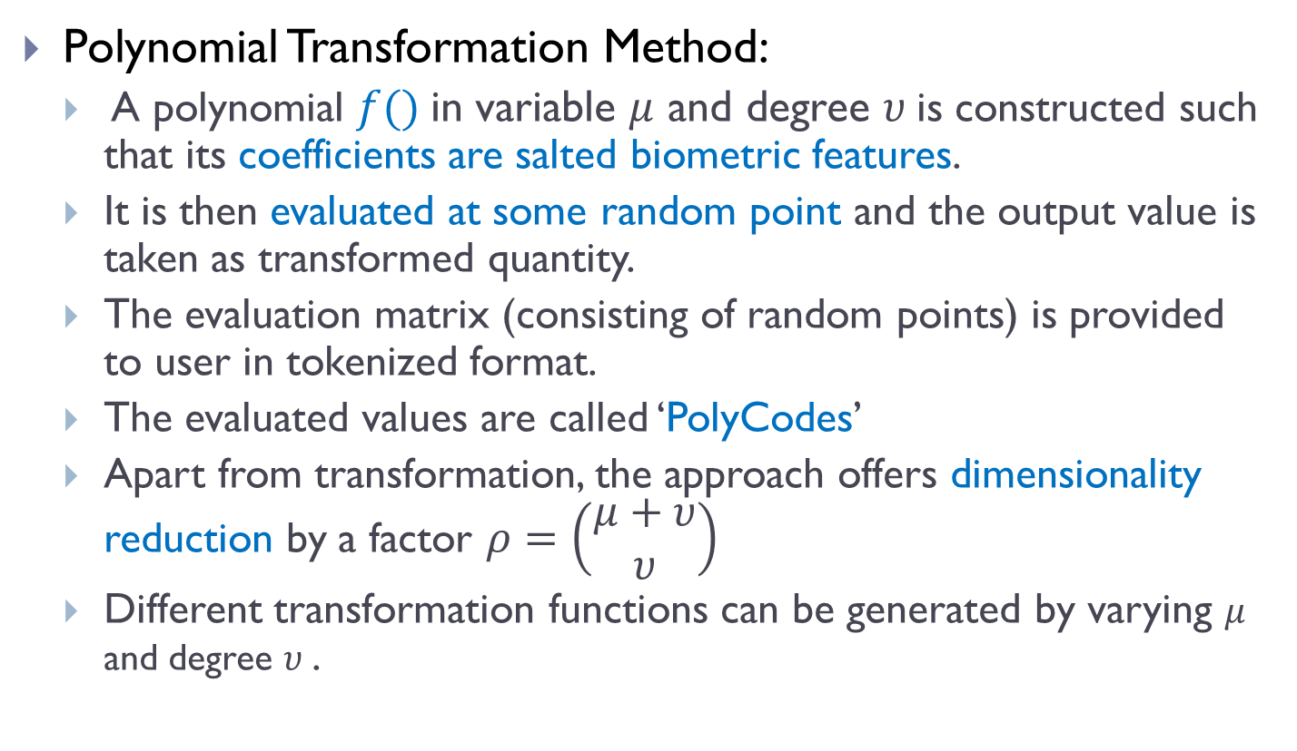
Proposed Method
Polynomial Transformation Method:
A polynomial $f()$in variable $μ$ and degree $υ$is constructed such that its coefficients are salted biometric features.
It is then evaluated at some random point and the output value is taken as transformed quantity.
The evaluation matrix (consisting of random points) is provided to user in tokenized format.
The evaluated values are called ‘PolyCodes’
Apart from transformation, the approach offers dimensionality reduction by a factor $ρ=\left(\begin{matrix}μ+υ \\ υ\end{matrix}\right)$
Different transformation functions can be generated by varying $μ$ and degree $υ$.

Slide 33
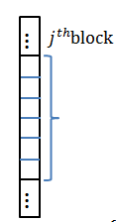
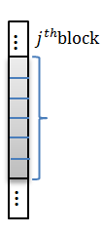
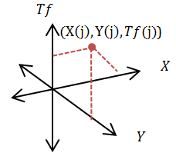
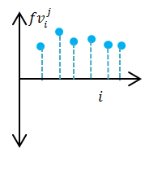
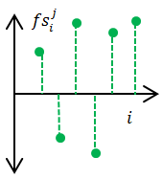


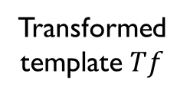
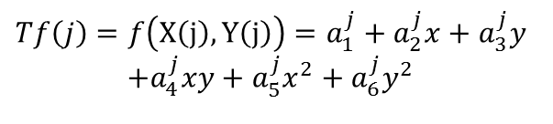
PolyCodes-22
$$fv$$
$$fs$$
Sensor
feature extraction
salting
Construct polynomial
$$Tf\left(j\right)=f\left(X\left(j\right),Y\left(j\right)\right)=a_{1}^{j}+a_{2}^{j}x+a_{3}^{j}y$$
$$+a_{4}^{j}xy+a_{5}^{j}x^{2}+a_{6}^{j}y^{2}$$
Transformed template $Tf$
PolyCodes-22: bi-variable polynomial in degree 2, dimensionality reduction by 75%.

Slide 34
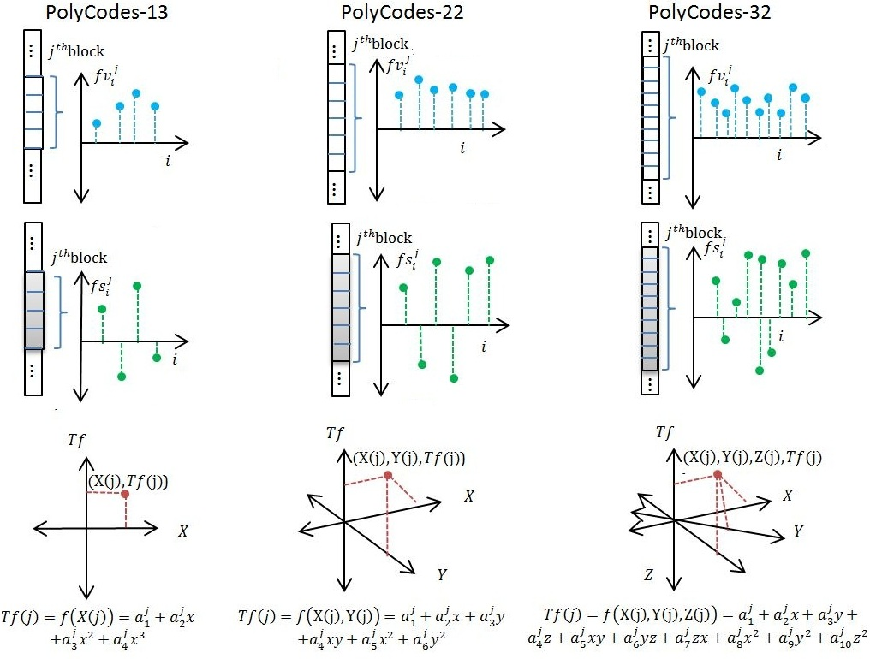
Proposed Approach-Illustration

Slide 35
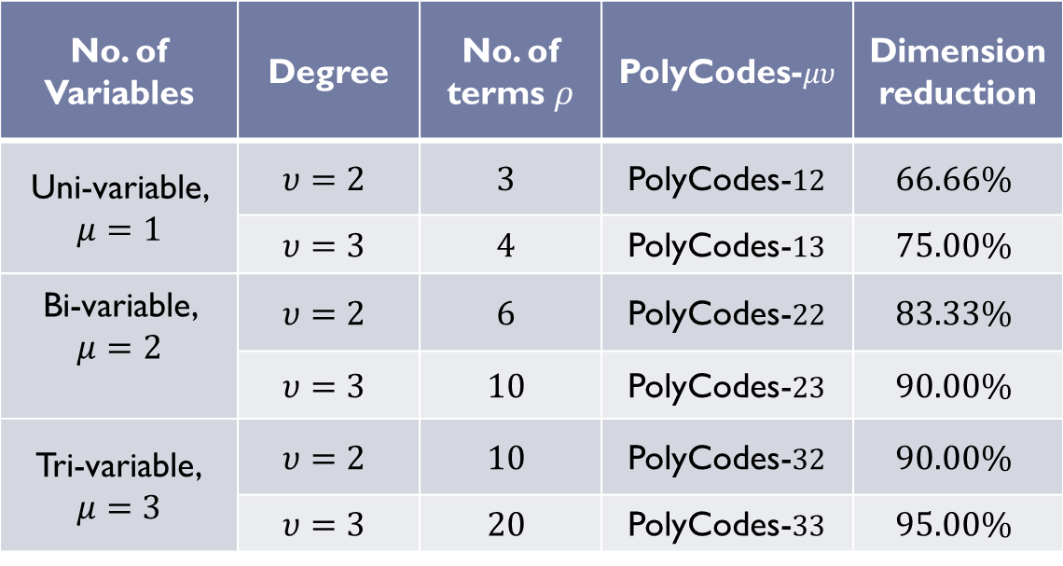

Notes:
The approach is tested for different combinations of $μ$ and $υ$ and output for each is known as ‘PolyCodes- $μυ$’
No. of Variables | Degree | No. of terms $ρ$ | PolyCodes-$μυ$ | Dimension reduction
Uni-variable, $μ=1$ | $$υ=2$$ | $$3$$ | PolyCodes-$12$ | $$66.66\%$$
 | $$υ=3$$ | $$4$$ | PolyCodes-$13$ | $$75.00\%$$
Bi-variable, $μ=2$ | $$υ=2$$ | $$6$$ | PolyCodes-$22$ | $$83.33\%$$
 | $$υ=3$$ | $$10$$ | PolyCodes-$23$ | $$90.00\%$$
Tri-variable, $$μ=3$$ | $$υ=2$$ | $$10$$ | PolyCodes-$32$ | $$90.00\%$$
 | $$υ=3$$ | $$20$$ | PolyCodes-$33$ | $$95.00\%$$

Slide 36
Performance Notes
Dimensionality Reduction
Flexible, viable performance upto 90 % dimensionality reduction.
Matching Performance (worst-case):
PC-12 at 67% reduction - similar to RD at 50% and RS-V1 at 50%, better than XOR at 50% .
PC-13 at 75% reduction - similar to and RS-V at 75%, better .
PC-22 at 83% reduction - comparable to BH-50 at 50% reduction.
PC-32 at 90% reduction - better than PC-23 at 90%.
Matching Performance (best-case):
Nearly 0% EER, high DI (>30) and, nearly 100% RI.
Changeability Performance:
CI is low, Cross-matching EER is high, nearly 50%, indicating no-match.

Slide 37
Comparisons

Slide 38
Comparisons for Feature Level Transforms
Dimension Reduction | Scheme | Average time in seconds | Performance Rank
50% | RD | 0.210 | 2
 | RS-V1 | 0.104 | 1
 | XOR | 0.136 | 3
66.66% | PC-12 | 0.574 | Btw 1-2
75.00% | RS-V2 | 0.156 | 1
 | PC-13 | 0.468 | 2
 | RP-XOR | 0.220 | 3
83.33% | PC-22 | 0.335 | Btw 1-2
90.00% | PC-23 | 0.358 | 2
90.00% | PC-32 | 0.298 | 1

Slide 39
Conclusions (1/2)
The proposed approaches were experimentally found to successfully fulfill all important criteria:
Revocability
Diversity
Non-invertibility
Performance
The performance in worst-case scenario is always found to be slightly less but comparable to original.
The performance in best-case scenario is always found to be better than original.
Ideal performance can be achieved in best-case, i.e., EER 0% and RI 100%, due to increase inter-user variations in transformed domain.
The approaches are found suitable for multiple visible and thermal modalities, i.e., face, thermal face, palmprint, palmvein, fingervein.

Slide 40
Conclusions (2/2)
Apart from transformation, proposed approaches are also helpful in reducing dimensionality of transformed features thereby reducing storage costs which indirectly also reduces matching time.
Dimensionality reduced upto 90%, while the system preserves the matching performance (worst-case). Best case, the operations are as good as ideal.
Advance template protection concept is helpful in preventing first-time compromise, direct replay and prevents statistical attacks on loss of user-token.
The remote architecture utilizes the benefits of cancelable biometrics to generate different pseudo-identities for different multi-server applications.
The secret sharing allows it all with a single-user token in a secure manner. NO need to carry different tokens for different applications.
Overall many attacks are address to develop a secure biometric authentication environment.

Slide 41
References
H. Kaur, P. Khanna, “Biometric template protection using cancelable biometrics and visual cryptography techniques,” Multimedia Tools and Applications, vol. 75, no. 23, pp. 16333–16361, 2016.
H. Kaur, P. Khanna, “Cancelable features using log-Gabor filters for biometric authentication,” Multimedia Tools and Applications, vol. 76, no. 4, pp. 4673--4694, 2017.
H. Kaur, P. Khanna, “Biometric Salting using Random Slope,” Pattern Recognition Letters, Elsevier, 2017 (under peer review)
H. Kaur, P. Khanna, “PolyCodes: Generating Cancelable Biometric Features using Polynomial Transformation,” IEEE Transactions on Information Forensics & Security, 2017 (under peer review).

